Slide 1


MODFLOW 6 Groundwater Transport Model
47TH IAH Congress
São Paulo, Brazil
August 22, 2021
Notes:
Describe some of the ongoing work we are doing with MODFLOW
MODFLOW and related software distributed by the USGS is developed and supported by a growing team of USGS scientists and external collaborators. Recent MODFLOW development efforts have focused on use of unstructured and locally refined grids for constant or variable-density groundwater flow and solute transport simulation, robust handling of three-dimensional anisotropy, generalization and tracking of water transfer between packages, distributed memory parallelization, and consolidation of these core capabilities into MODFLOW 6. These capabilities make it possible to construct new types of models, such as tightly coupled nested models, that have not been possible with previous MODFLOW versions. Underlying these efforts has been the adoption of an open-development philosophy that relies on testing-based development and continuous integration practices by the core development team and by the broader MODFLOW community. Ongoing development increasingly relies on the Flopy python package for automating model construction. Resulting from these development efforts is a suite of MODFLOW programs that can be applied at local, regional, and National scales for a wide variety of complex groundwater flow and transport problems.
OASIS MCT

Slide 2
MODFLOW 6 groundwater transport model

Slide 3
Transport Model
New model type in MODFLOW 6 called GWT
Can run concurrently with GWF, or
Can run by itself using saved GWF results
Alternative to MT3D
MT3D-USGS will work with MODFLOW 6 output for regular grids
Works with regular or unstructured grids
Works with the Newton flow formulation
Simulates advection, dispersion, sources and sinks, sorption, decay, and any number of immobile domains
Can simulate transport in lakes, streams, wells, and the unsaturated zone
Implicit formulation (no particles)
Second-order TVD
Optional use of XT3D for dispersion

Slide 4
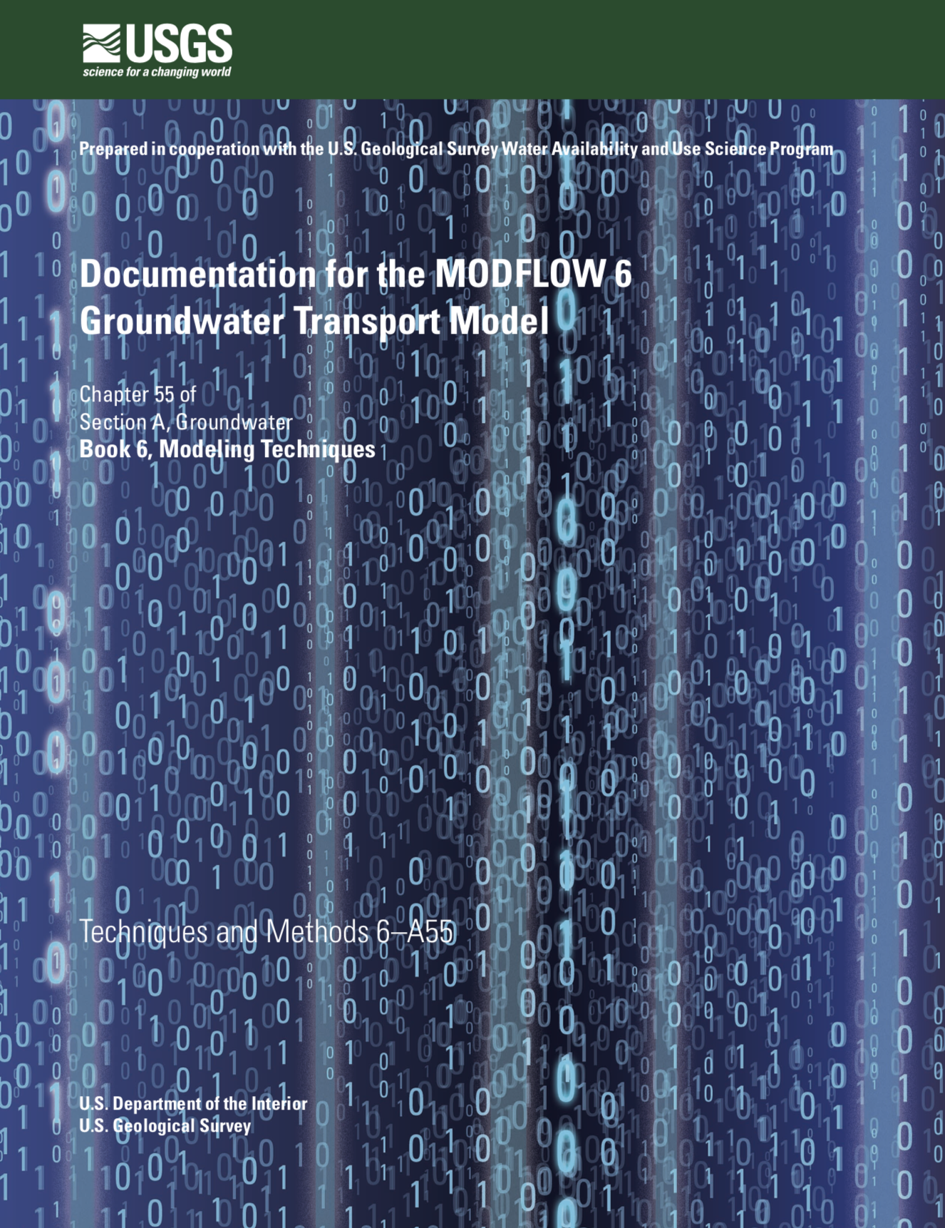
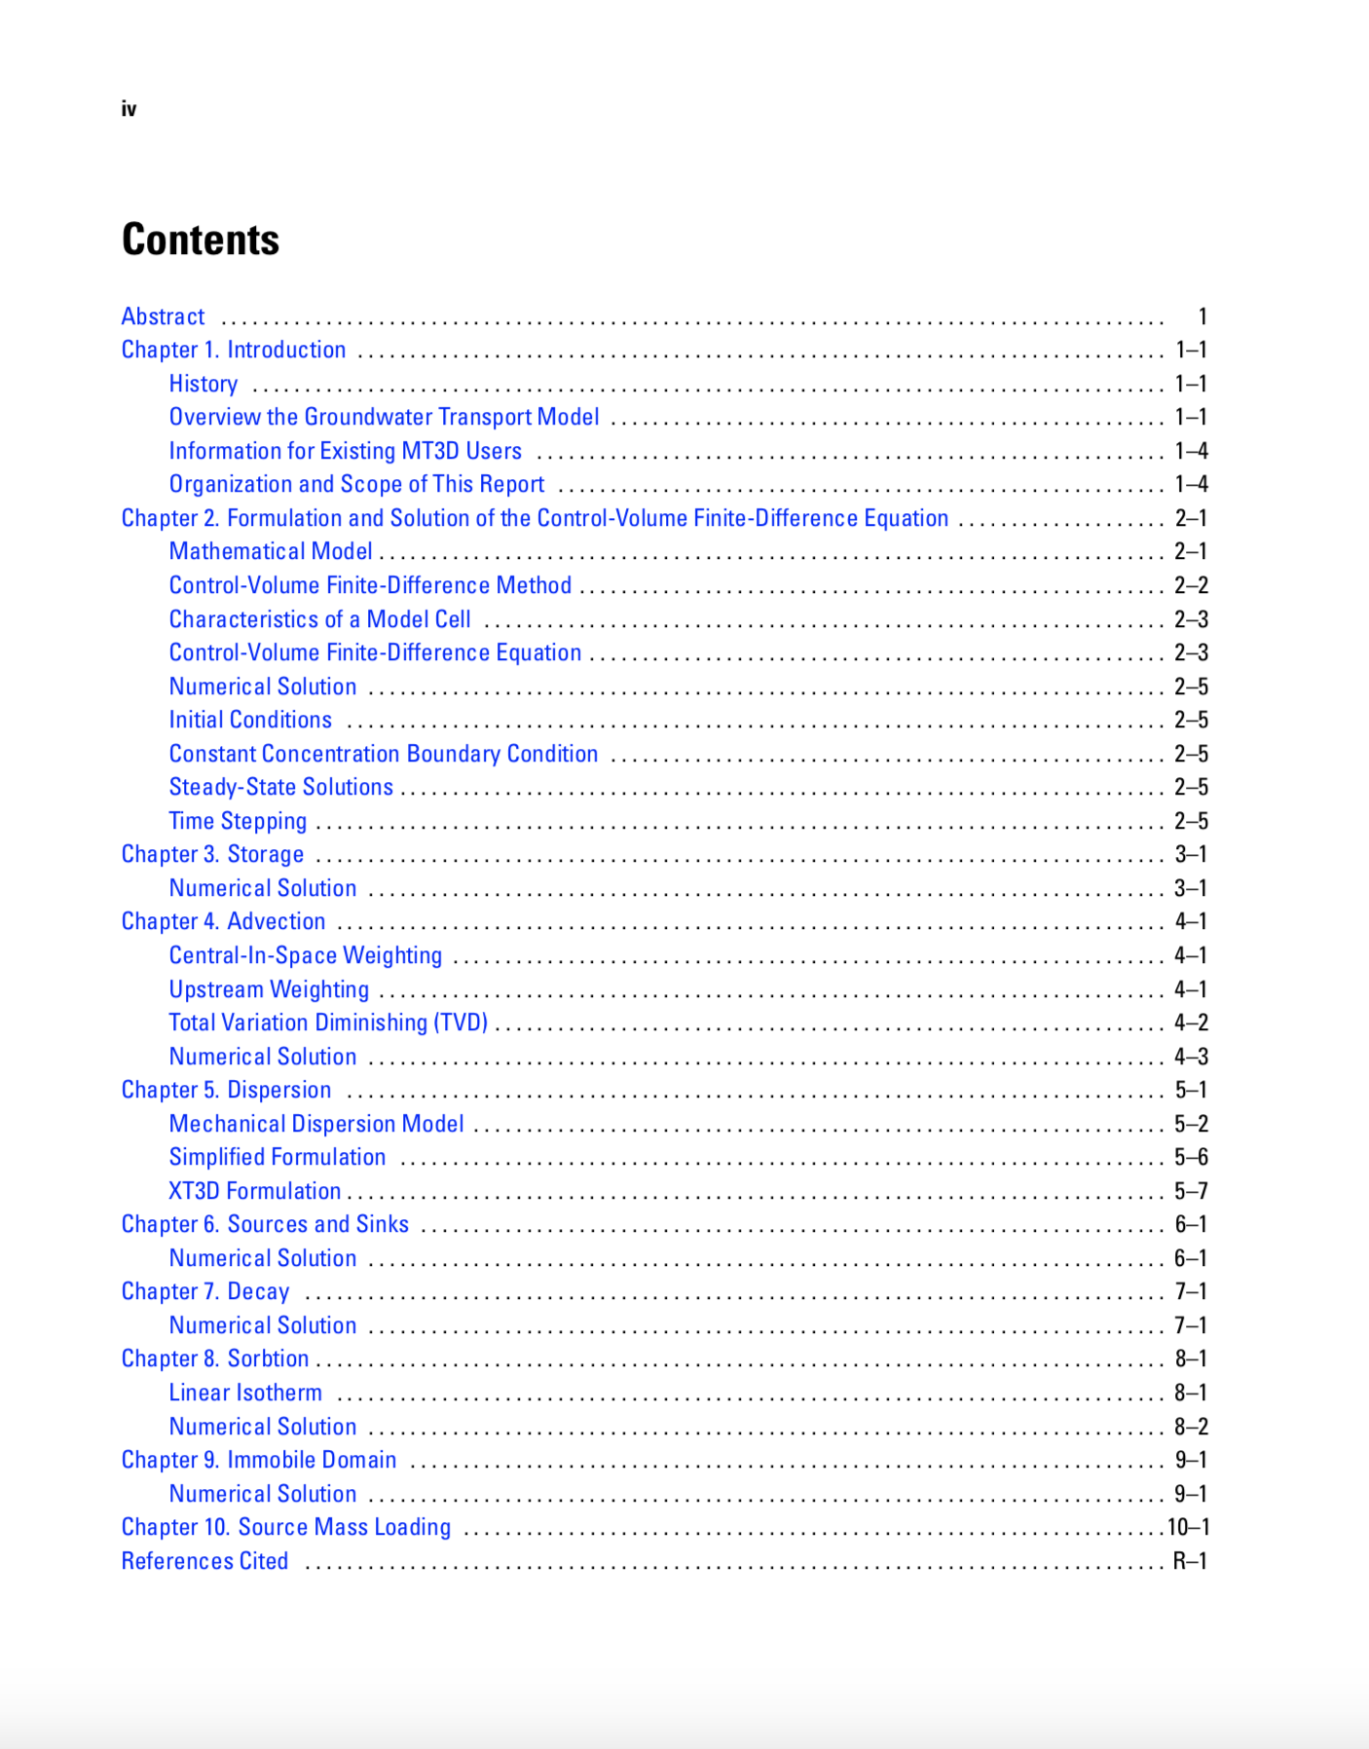
Documentation in Preparation

Slide 5
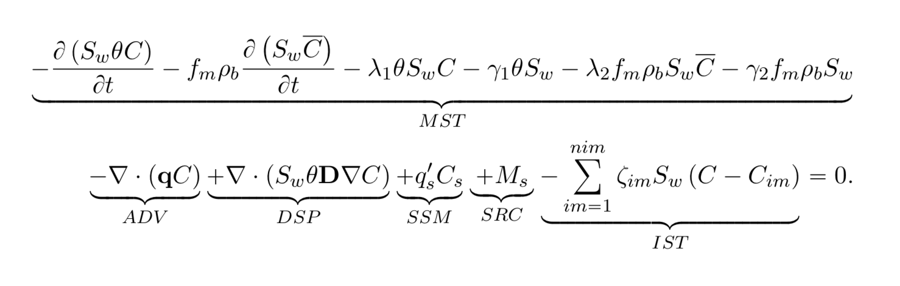
Transport Equation

Slide 6
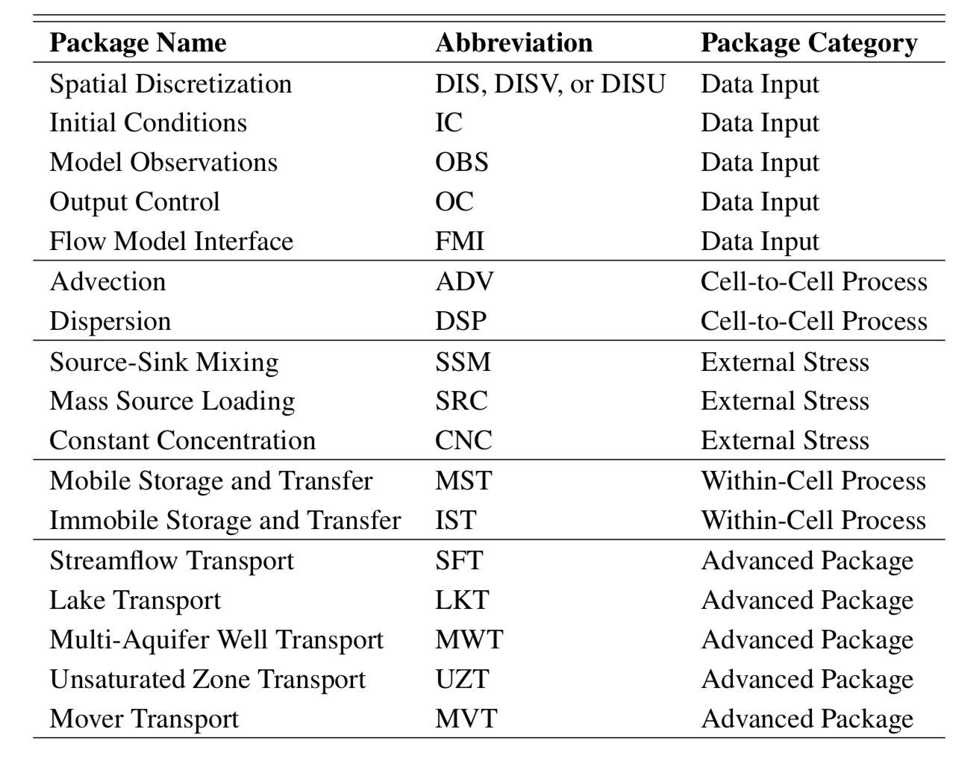
GWT Packages

Slide 7
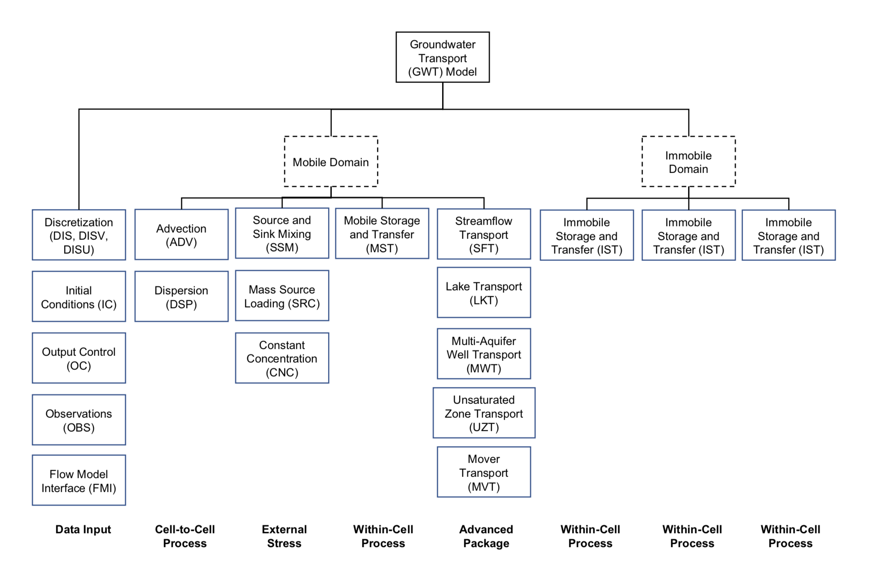
Domain and Package Structure

Slide 8
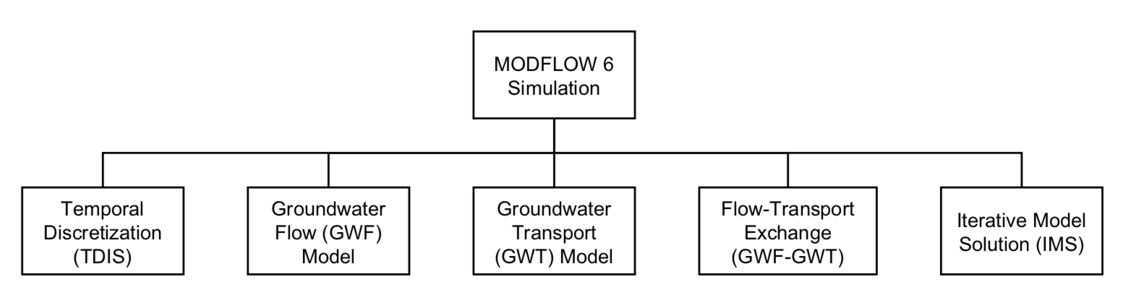
Typical GWF-GWT Simulation

Slide 9
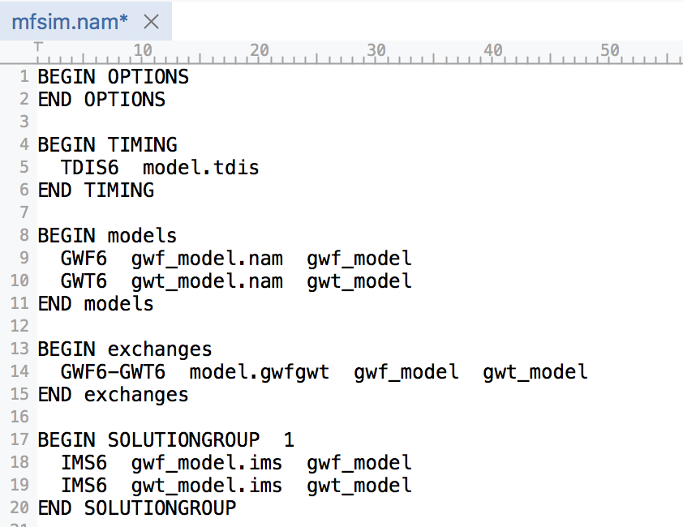
Simulation Name File

Slide 10
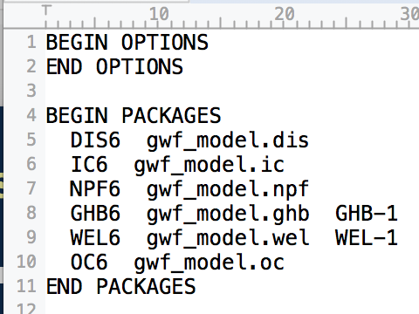
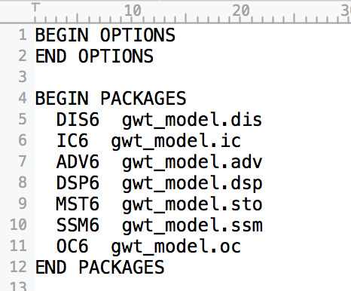
Model Name Files
GWF Name File
GWT Name File

Slide 11
Limitations
Flow and transport grids must be identical
Time step lengths are specified by the user in the TDIS package
No particle methods
Version 1:
No transport from one GWT model to another one (but working on this now)
Single species, but can specify multiple GWT models, with each one representing a different species

Slide 12
Newton Formulation for Dry Cells
Q_{rch}
1
2
h₁
h₂
3
h₃

Slide 13
Transport Formulation for Dry Cells
Q_{rch}C_{rch}
1
C₁ = C_{rch}
2
C₂ = C_{rch}
3
C₃ = f(C_{rch}, …)

Slide 14
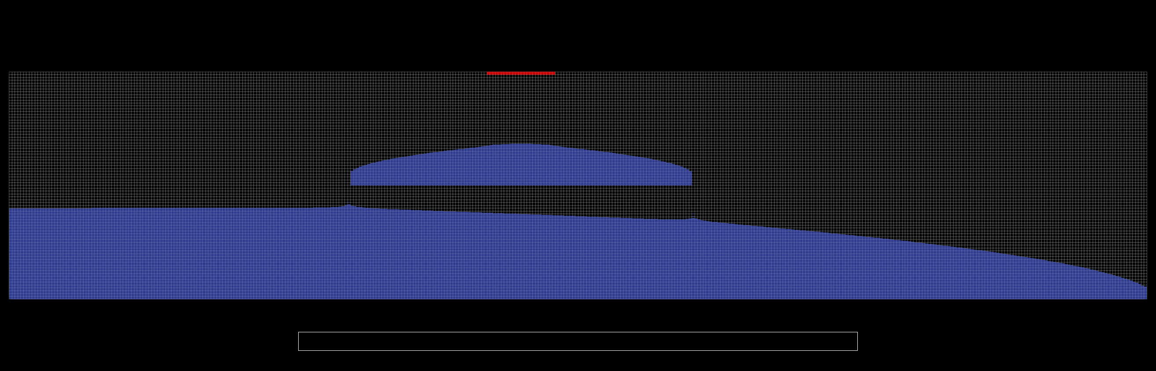
Keating Example
Transport through dry cells

Slide 15
SEAWAT Capabilities
Simulated concentrations can be used to calculate densities used by the GWF Buoyancy Package
Compatible with unstructured grids and the Newton flow formulation

Slide 16
Freshwater Head Formulation
SEAWAT uses a freshwater head formulation
Problem: freshwater head is not the water table
Notes:
q = - K_0 \left [ \nabla h_f + \left ( \frac{\rho}{\rho_0} - 1 \right ) \nabla z \right ]

Slide 17
Alternative Hydraulic Head Formulation
What about a hydraulic head formulation?
Head is the dependent variable and the water table
Notes:
q = - K_0 \left [ \nabla h_f + \left ( \frac{\rho}{\rho_0} - 1 \right ) \nabla z \right ]

Slide 18
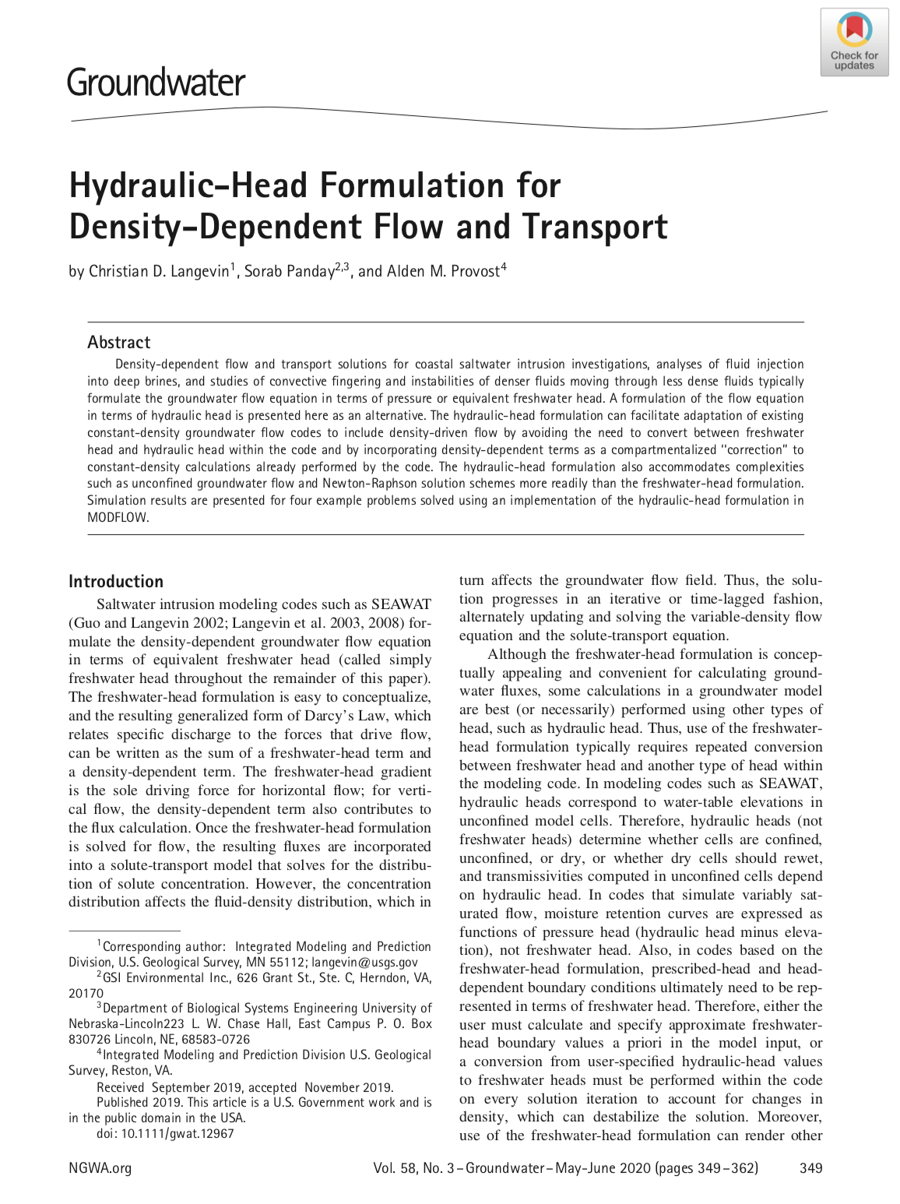
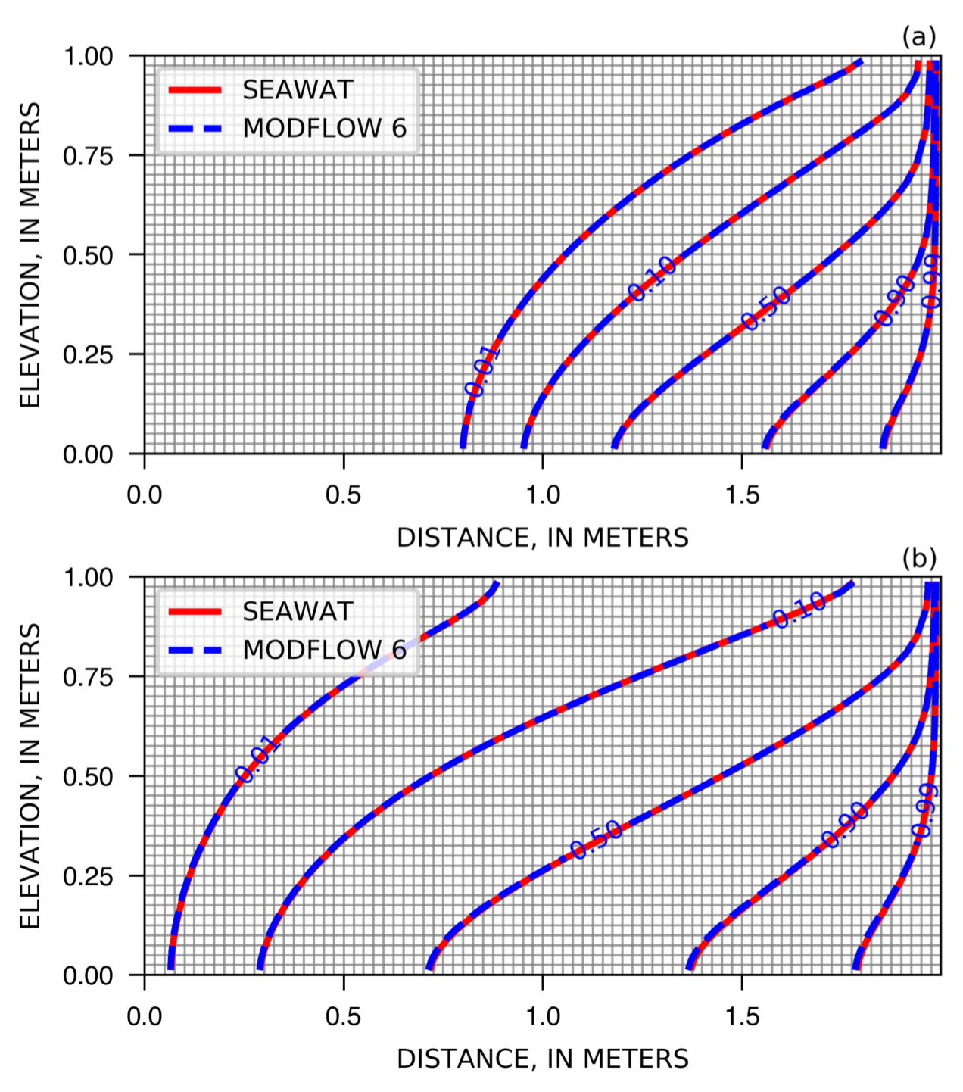
Hydraulic-Head Formulation Manuscript

Slide 19
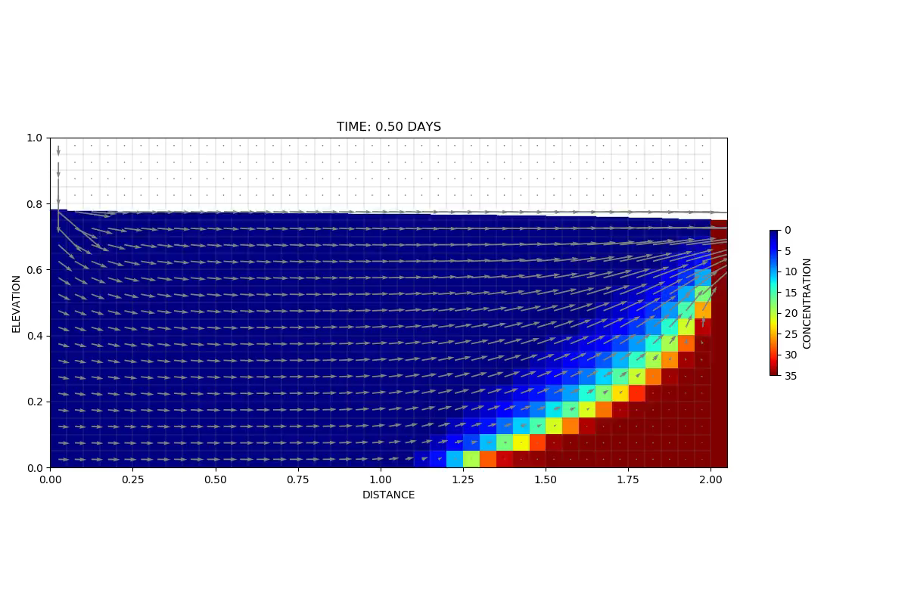
MODFLOW 6 Animation
Notes:
10 seconds to run this.

Slide 20
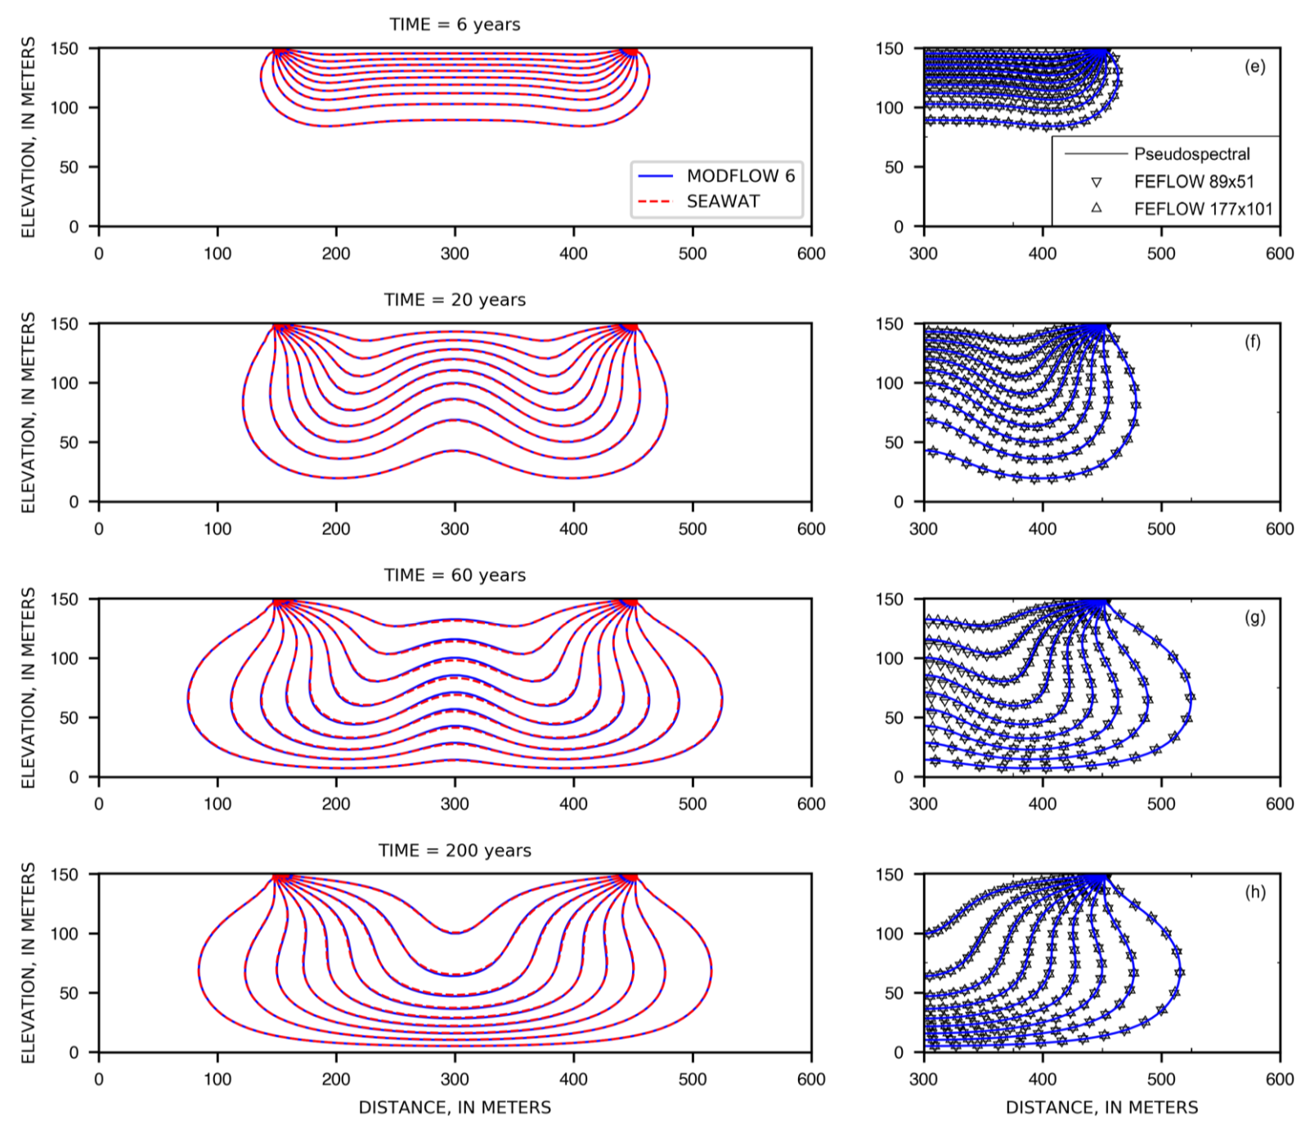
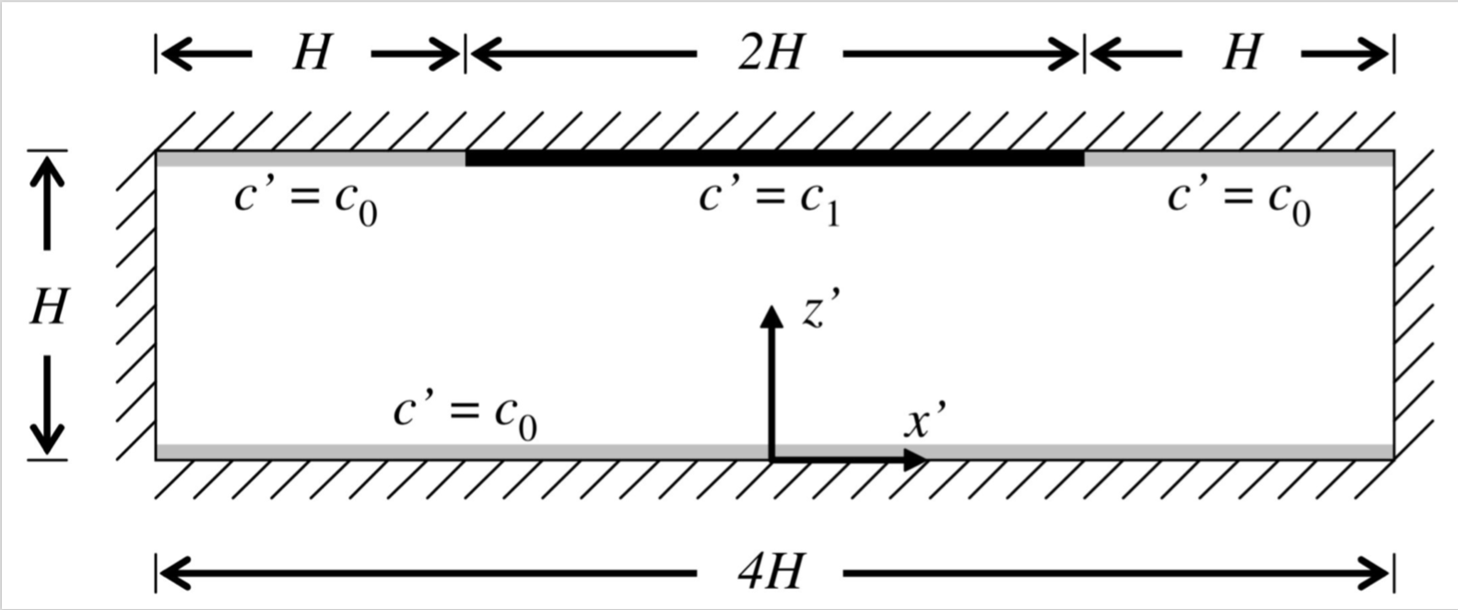
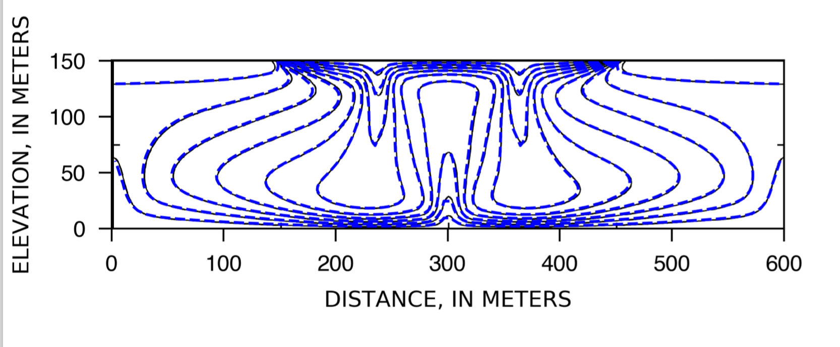
Elder-Like Problem

Slide 21
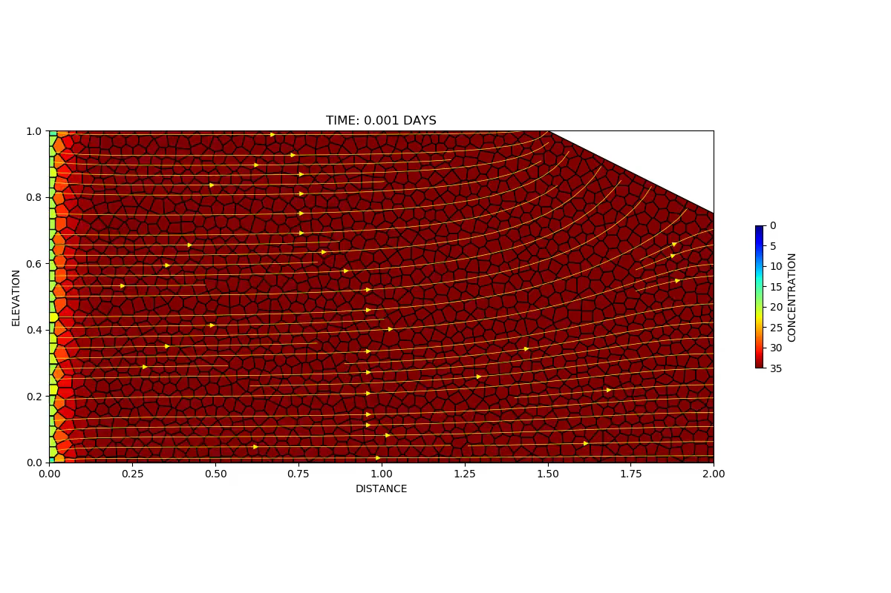
Unstructured Cross-Section Simulation

Slide 22
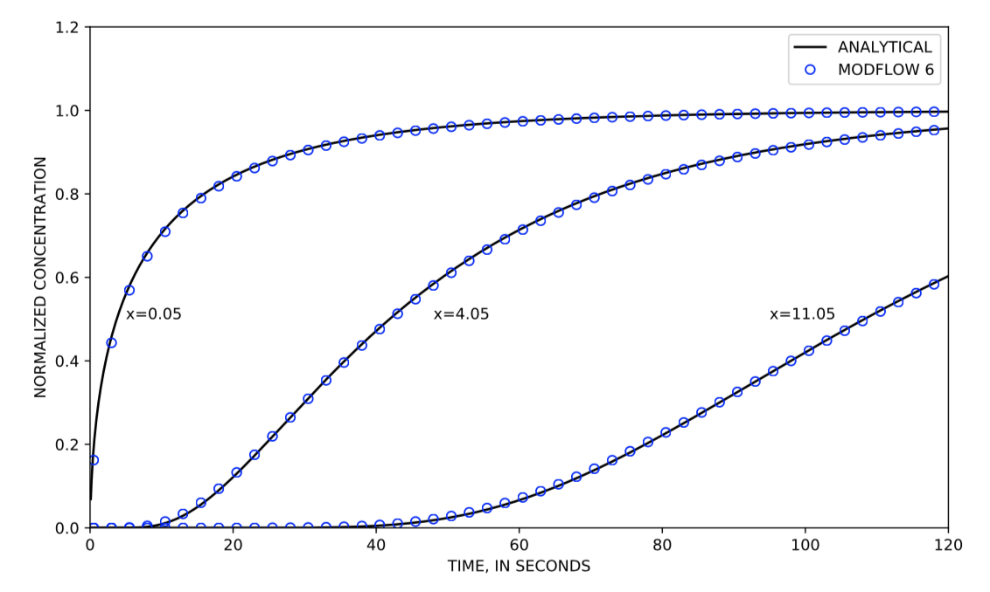
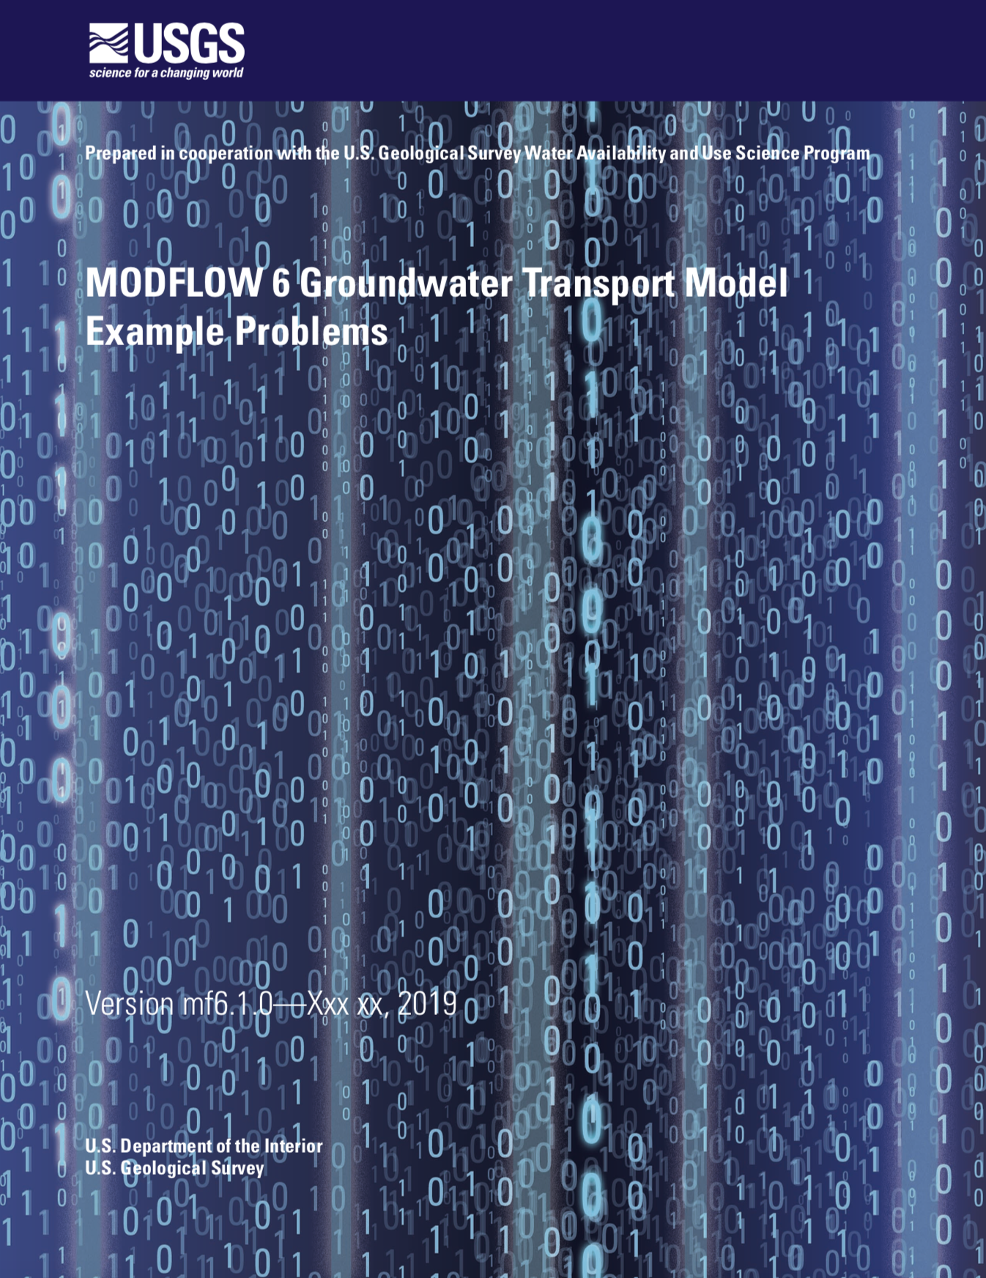
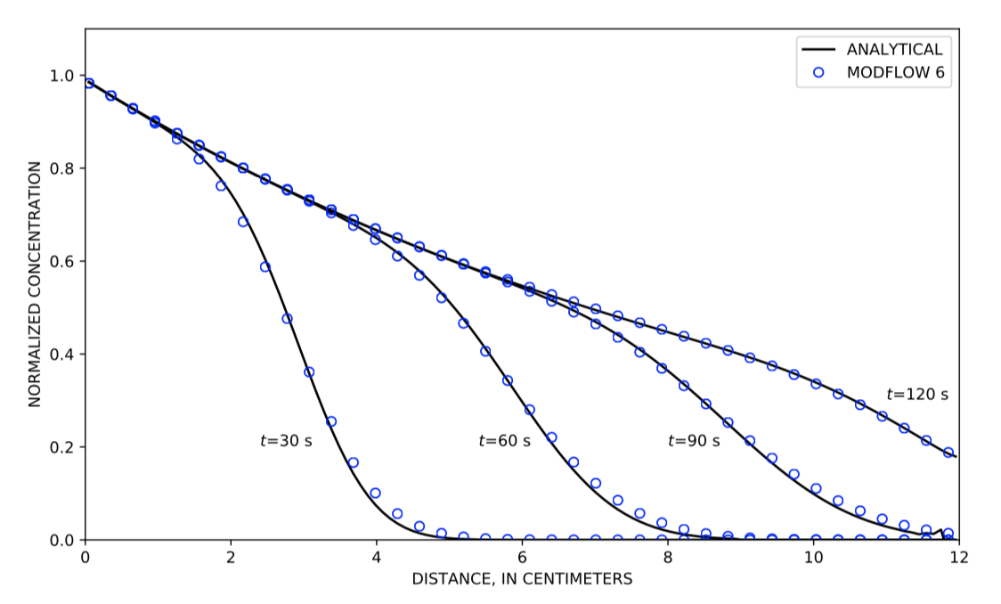
Examples Document

Slide 23
QUESTIONS?

